Slide 1

DoConnect - Technical Q&A Platform
A Comprehensive Technical Question & Answer Platform
Presented by [Student Name]
Batch [Batch Number] | Instructor [Instructor Name] | September 2025

Slide 2
Problem & Objectives
The Challenge
Our Solution: DoConnect
Key Goals
Developers lack reliable, structured knowledge-sharing platforms.
A moderated Q&A platform for technical queries.
Delivering a seamless user experience.
Structured knowledge base
Intuitive interface
Scattered information
Expert community engagement
Real-time notifications
Inefficient troubleshooting
Robust security

Slide 3
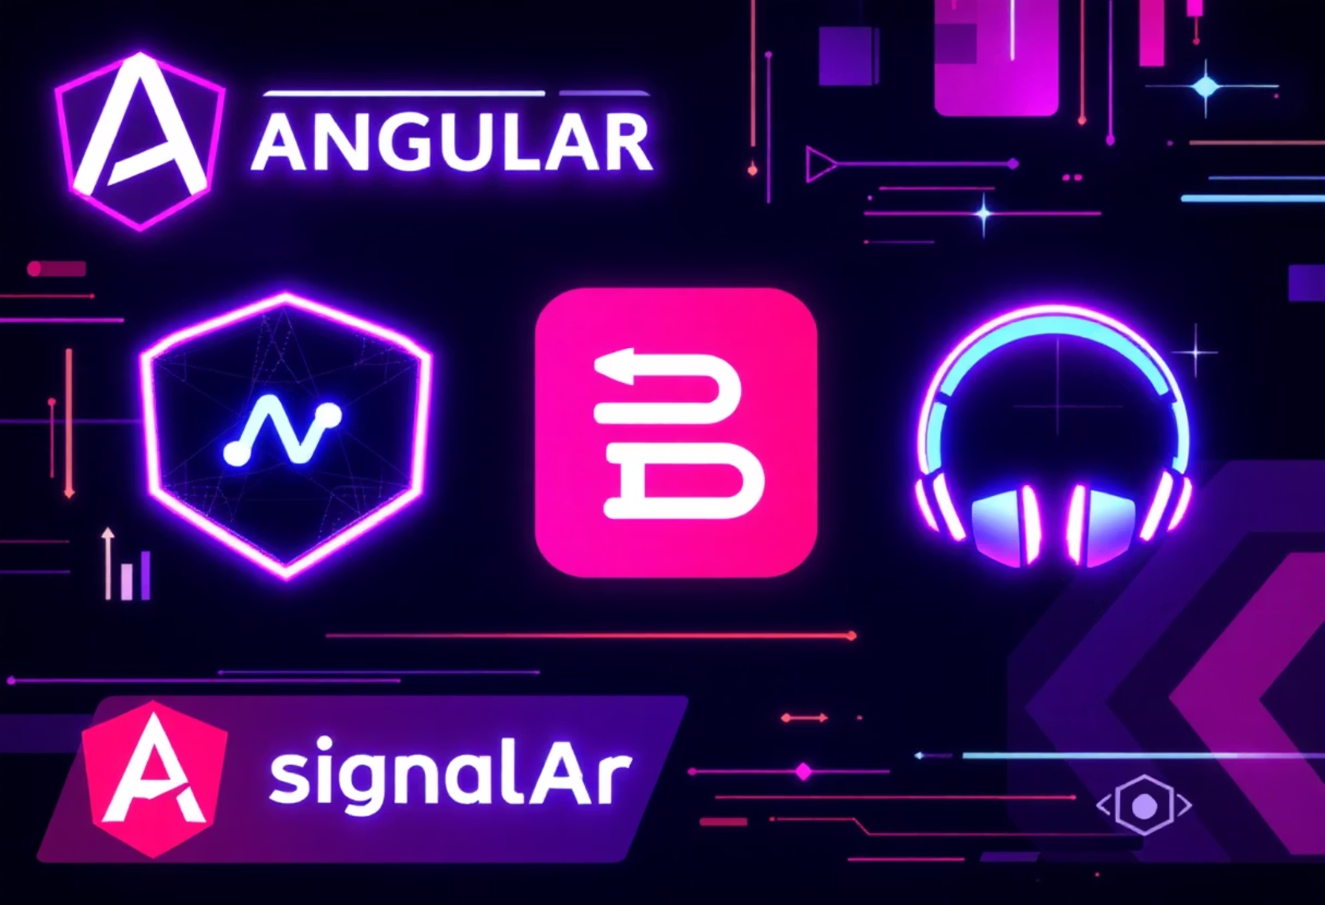
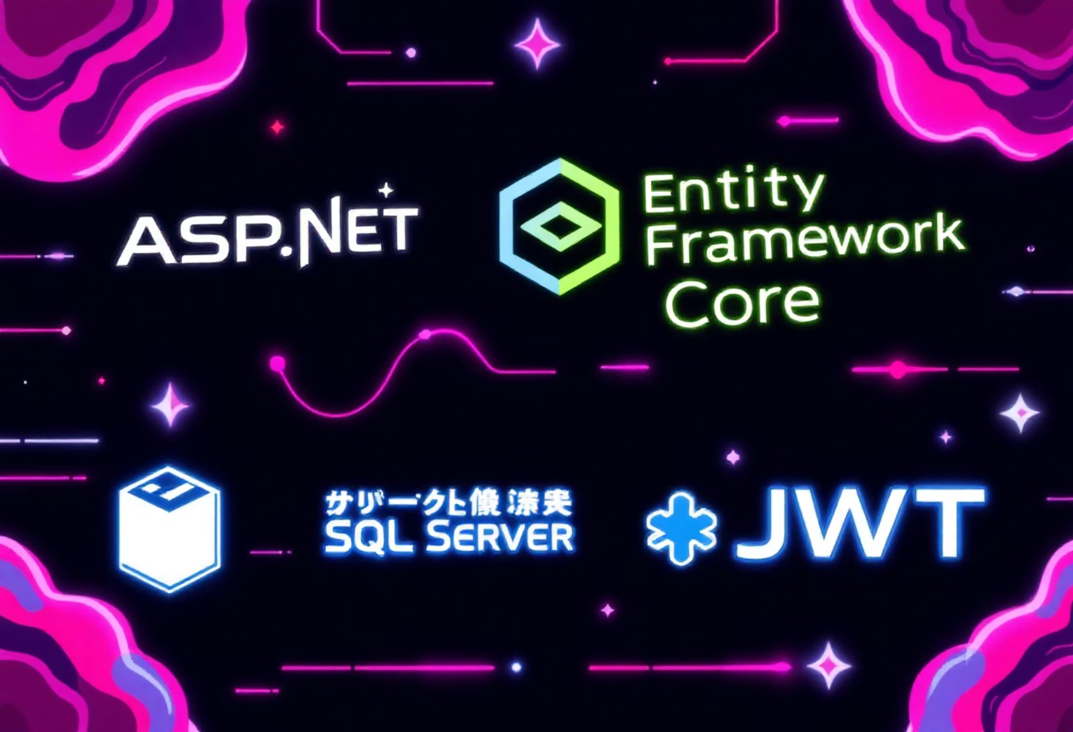
Technology Stack
Leveraging modern frameworks for performance & scalability.
Frontend
Backend
Angular 14+
ASP.NET Core 8
Bootstrap 5
EF Core
SignalR (client)
SQL Server
JWT for Auth

Slide 4
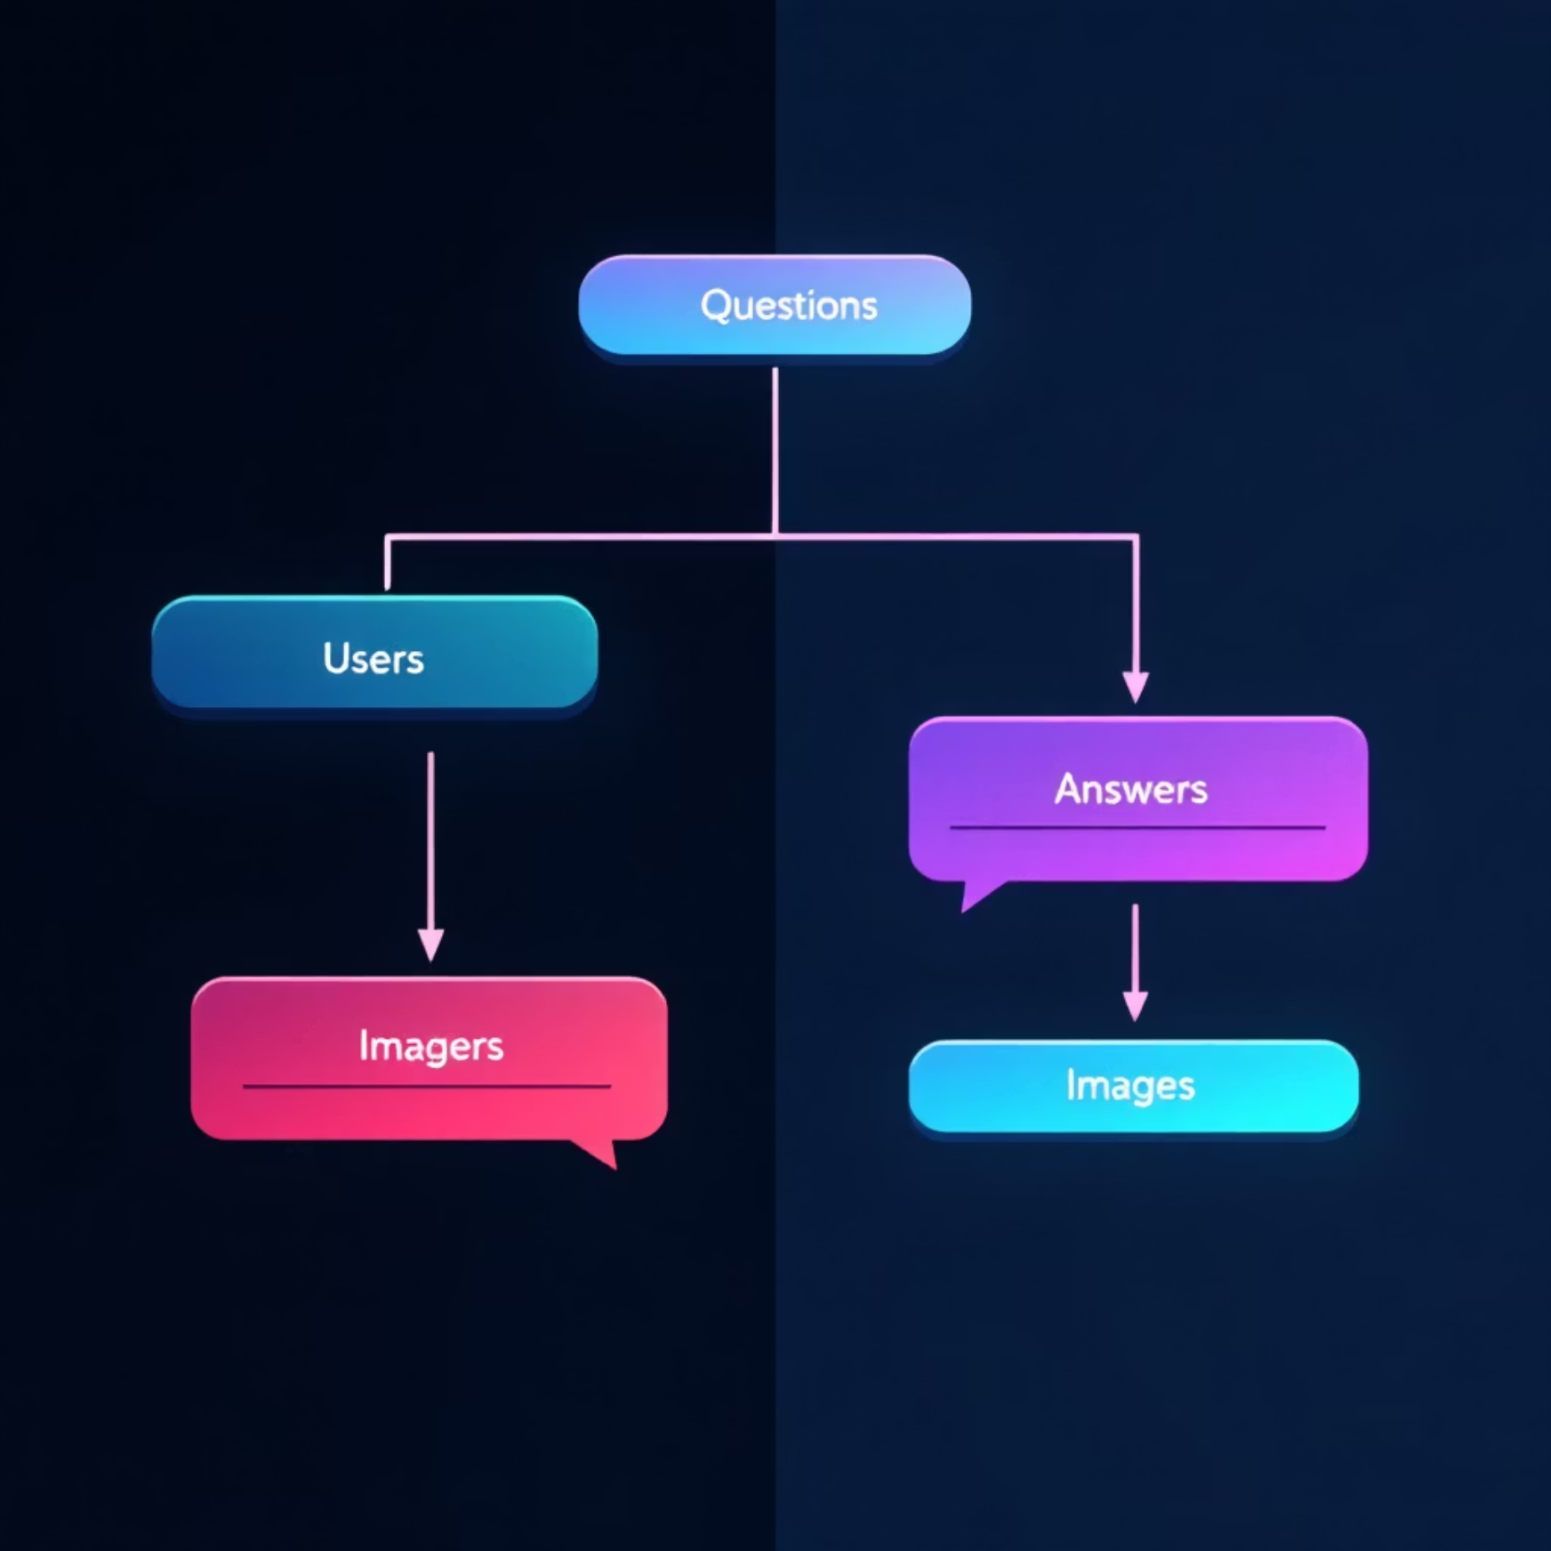
Architecture & Database Design
System Architecture Layers
Core ER Diagram
Client Layer
Angular Single Page Application (SPA)
API Layer
RESTful Endpoints with ASP.NET Core
Business Logic
Core platform functionalities
Data Access
Entity Framework Core
SQL Server
Relational Database
Users: Authentication, profiles
Questions: Title, content, tags
Answers: Content, associated question
Images: Uploads for questions/answers

Slide 5









Key Features
User Functionality
Admin Capabilities
Account Management
Admin Dashboard
Registration, Login, Profile updates.
Overview of platform activity.
Q&A Interaction
Content Moderation
Ask questions, post answers, comment.
Manage questions, answers, and comments.
Image Upload
User Management
Enhance content with visuals.
Control user accounts and roles.
Search & Dashboard
Real-time Alerts
Efficient content discovery and personal overview.
Instant notifications for critical events.

Slide 6

Sprint Implementation Timeline
Sprint 1: Foundation
Database design and initial setup.
SQL Server schemas
EF Core integration
Sprint 2: Core Functionality
Authentication, CRUD operations, Image upload.
JWT implementation
Sprint 3: Enhancements & Admin
Basic Q&A creation
Admin panel, search, and real-time notifications.
Moderation tools
SignalR integration
An Agile approach ensuring incremental delivery and continuous improvement.

Slide 7
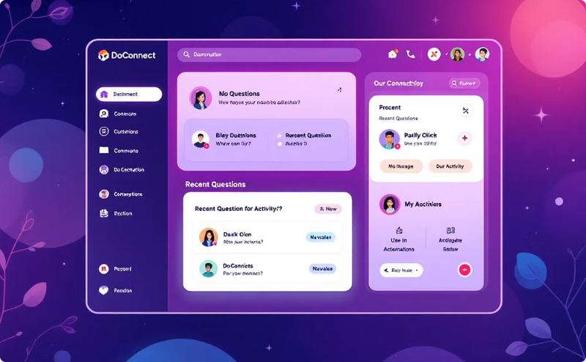

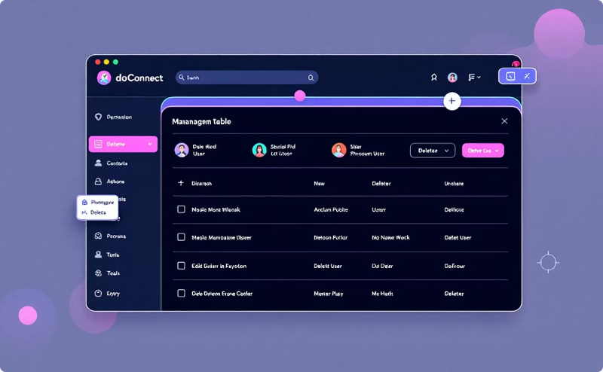
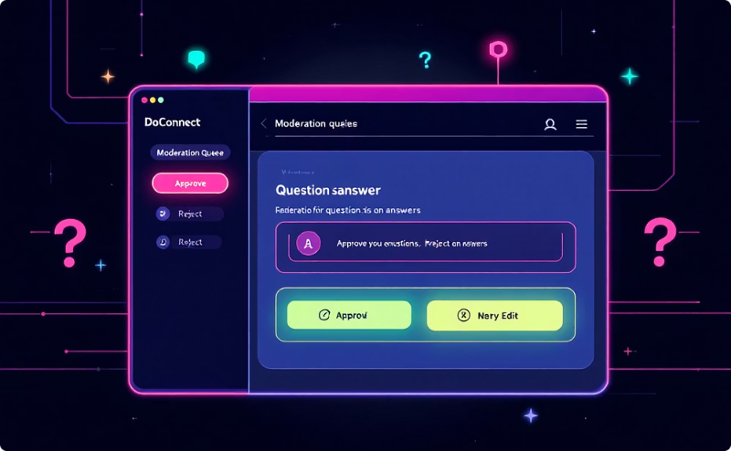
UI & Admin Showcases
User Dashboard
Q&A Detail Page
Admin User Management
Content Moderation
Personalized view of activity and content.
Engage with questions and answers.
Control and oversee user accounts.
Maintain platform quality and standards.

Slide 8
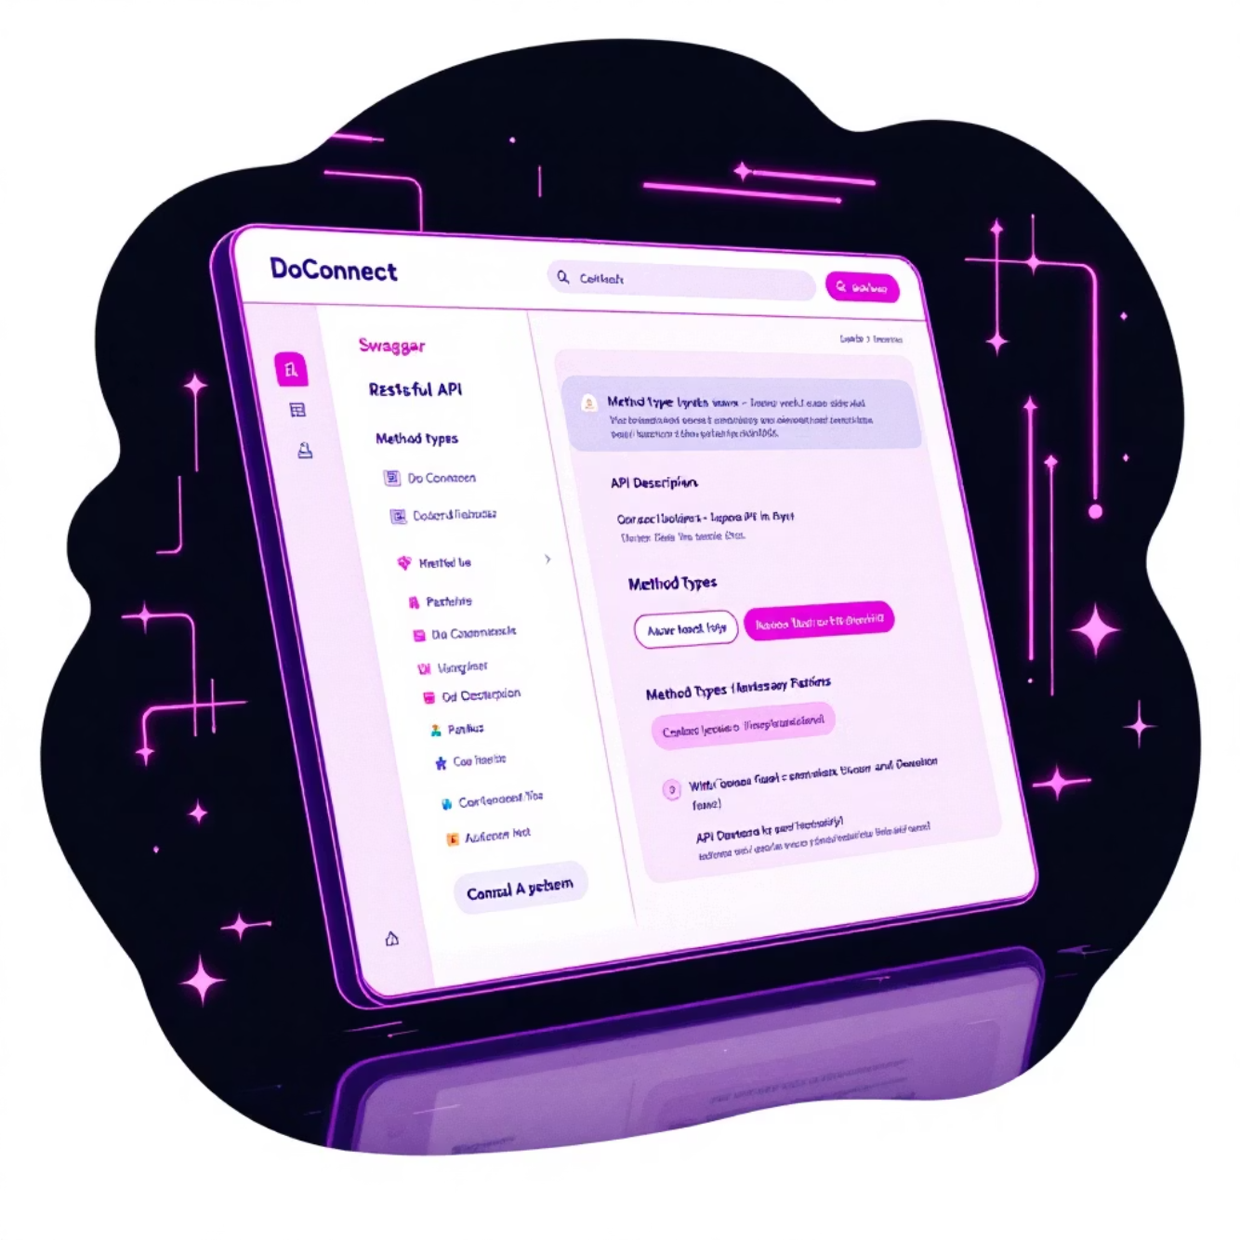
API, Security & Real-time Communication
Robust Backend & Security
API Documentation
RESTful APIs
Dedicated endpoints for all functionalities (Auth, Q&A, Admin).
Advanced Security
JWT, Role-based access control, CORS, Data validation.
Real-time Updates
SignalR for live notifications & content updates.
Comprehensive API documentation for seamless integration.

Slide 9
Deployment, Testing & Achievements
Deployment Strategy
Key Achievements
Frontend
1
Full-stack Proficiency
Netlify for Angular SPA
Mastery across frontend, backend, and database.
2
Real-time Capabilities
Backend
Seamless live updates and notifications via SignalR.
Azure App Service for ASP.NET Core
3
Secure Authentication
Database
Robust JWT and role-based access control.
Azure SQL Database
4
Responsive UI/UX
Testing Protocol
Optimized for various devices and screen sizes.
Unit Testing: Component & logic validation
Integration Testing: API and service interactions
5
Comprehensive API
End-to-End Testing: Full user flows
Performance Testing: Scalability and responsiveness
Well-documented and efficient RESTful services.

Slide 10

Roadmap & Conclusion
Future Enhancements
Questions?
AI-powered content suggestions
Dedicated mobile application
Advanced analytics dashboard
Multi-language support
Key Learnings
Thank you!
Full-stack development lifecycle
GitHub: [Your GitHub Link]
Real-time communication patterns
Contact: [Your Email]
Database optimization techniques
Agile sprint methodologies

